Slide 1
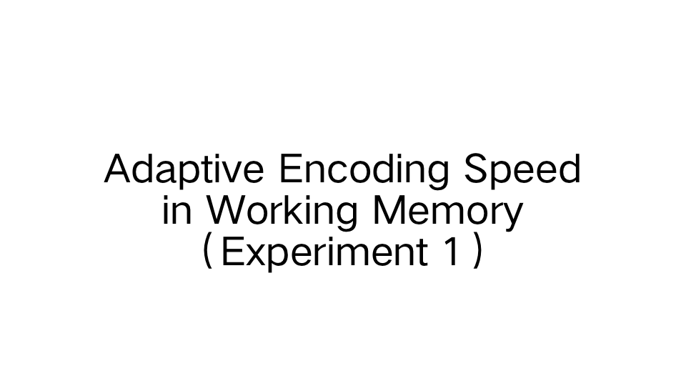

Slide 2
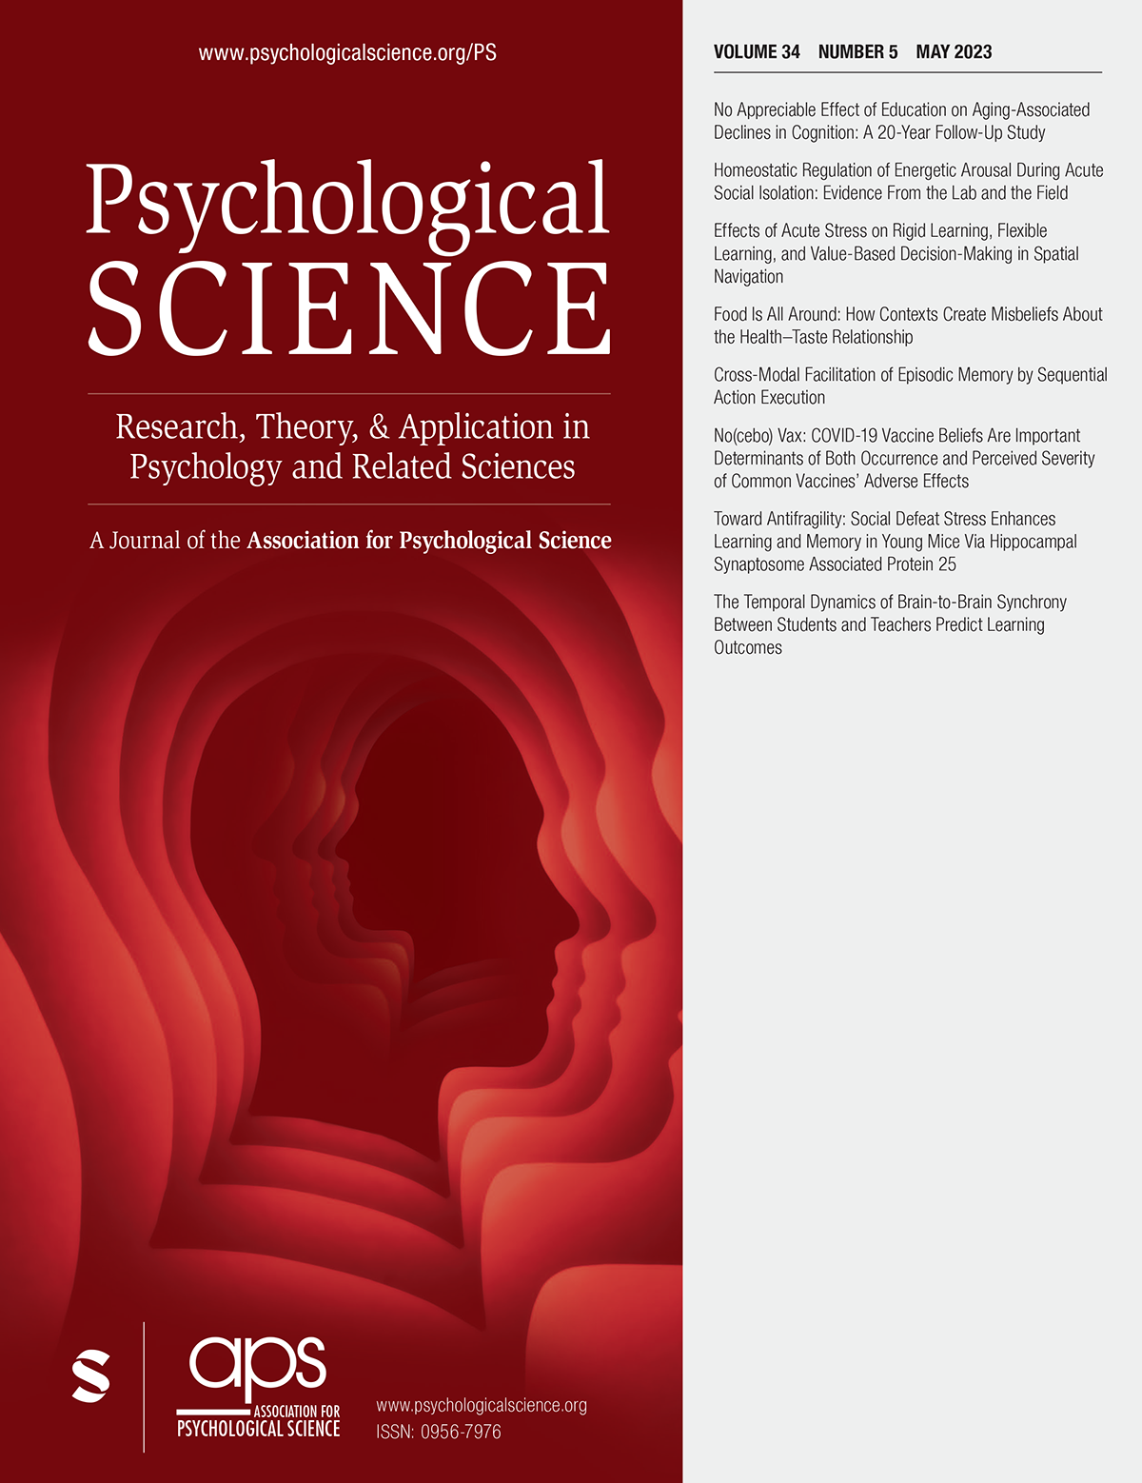
Psychological Science
10.172（2021)
cutting-edge research articles and short reports
cognitive, social, developmental, and health psychology
novel research methodologies and the newest, most innovative techniques of analysis

Slide 3

Joost de Jong
Netherlands,University of Groningen
Faculty of Behavioural and Social Sciences
Experimental Psychology
PhD student
A common dynamic prior for time in duration discrimination(Psychonomic Bulletin & Review)

Slide 4
Membership information
Group leader:
Wu Yu--code reproduction, discussion , conclusion,result reporting
Group members:
Wang Xiaoxiao-- code reproduction, instruction, method, procedure
Geng Piaopiao-- code reproduction, code ，reference
Xiong Ruyu--code reproduction; results

Slide 5
Introduction
Background Information
Information arrive at a fast rate could be encoded at a faster rate
The encoding speed of working memory is adjusted based on the expected duration of stimulus（adaptive dynamics ；encoding speed ；working memory ）
Hypothesis
encoding would speed up when the expected stimulus duration was brief

Slide 6
Open Practices Statement
All materials, data, and analysis code for Experiments 1 to 3 have been made publicly available on OSF and can be accessed at https://osf.io/d5rnu/. None of the experiments were preregistered.

Slide 7
Method
Participants:first-year psychology students(63% female)
Apparatus:a 19-in. CRT screen,100 Hz,1,280 × 1,024 pixels
Stimuli:Gabor patches with a Gaussian envelope
Procedure:1.A fixation dot was shown for 500 to 1,000 ms
2.presented the memory item (50, 200, or 400 ms)
3.present a pattern mask for 100 ms
4.retain the memory item over the next 1,000 ms

Slide 8
Experiment 1: blocked presentation time
N = 57
a higher overall presentation time increases encoding speed？
1.each block either had a predominantly short presentation time (50 ms: 70% of trials, 200 ms: 15%, 400 ms: 15%)
2.predominantly long presentation time (50 ms: 15% of trials, 200 ms: 15%, 400 ms: 70%)
four blocks of 40 trials each (i.e., 160 trials in total)
participants switched

Slide 9
Experiment 2: sequential presentation time
N = 24
encoding speed adapt to recent, sequential changes？
A de Bruijn sequence:perfectly counterbalances the order of its elements up to a certain degree using the smallest sequence length.
The sequence such that each possible order of three presentation times (e.g., 50 ms, 200 ms, 400 ms) would occur with equal frequency within each block.

Slide 10
Experiment 3: cued presentation time
N = 19
adaptations,explicit cues,highly informative
At the start of each trial, we presented either the word “FAST” in red or “SLOW” in blue for 400 ms(80% valid).
“Fast” cues predicted 50-ms presentation times 80% of the time (with 10% for both 200 and 400 ms), and “slow” cues predicted 400-ms presentation times 80% of the time (with 10% for both 50 and 200 ms).

Slide 11
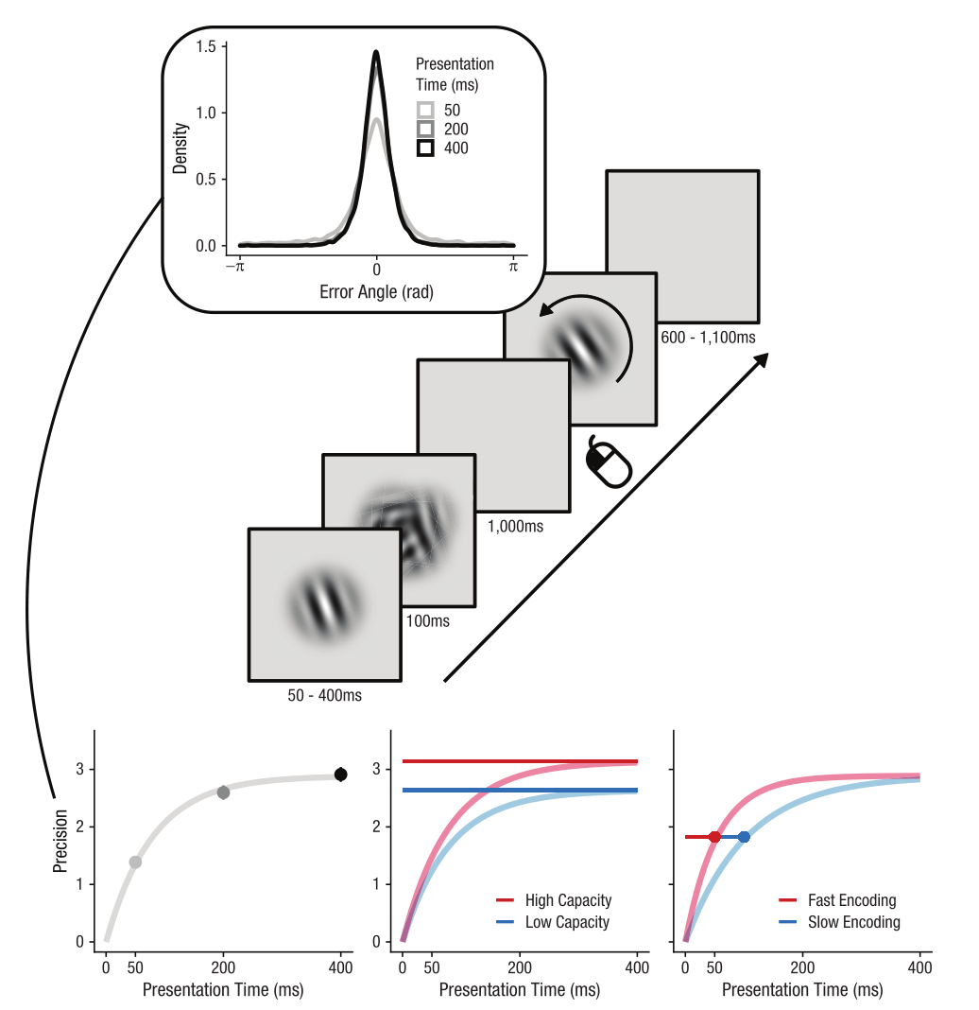


Analysis
R (Version 3.5.1; R Core Team, 2018)
Error angles:(reproduced angle-actual angle)*2
Memory precision: the circular standard deviation(σ⁻¹)
maximum capacity (c) and encoding speed
Figure 1

Slide 12
Results 1: working memory can adapt
participants adjust their encoding speed based on their presentation time: the shorter the presentation time, the faster their encoding speed (β = 0.149, t = 3.76, p < .001, BF10 = 89.82, ΔBIC = 9.00)
Shorter presentation time can increase working memory capacity (β = 0.09, t = 3.29, p = .001, BF10 = 19.11, ΔBIC = 5.90).
(the adjustment of encoding speed is independent of capacity, as researchers kept capacity standardized throughout the experiment. )

Slide 13
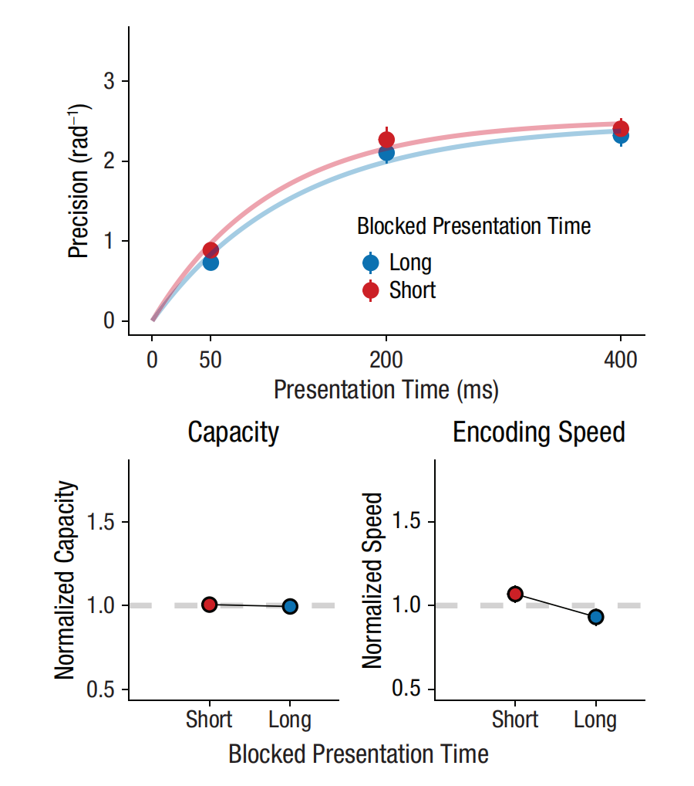
Figure 2

Slide 14
Results 2：Presentation order affects encoding speed
the shorter the presentation time in the previous experiment, the faster the encoding speed in the current experiment 2 (β = -0.00053, t = -2.68, p = .009, BF10 = 4.21, δBIC = 2.88; Figure 3).
When the previous two stimuli have the same presentation time, the encoding speed is faster (β = -0.00178, t = -5.08, p < .001, BF10 > 10,000, δBIC = 18.49; Figure 4).
the effect of the first two stimuli on encoding speed is stronger than the effect of the most recent single stimulus (Z = -4.686, p < .001).

Slide 15
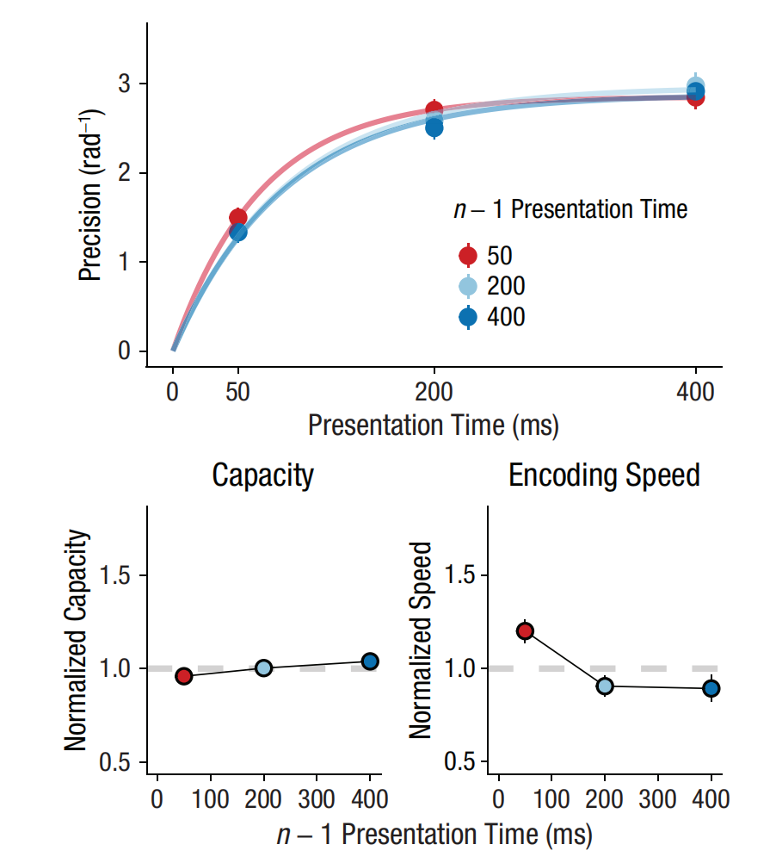
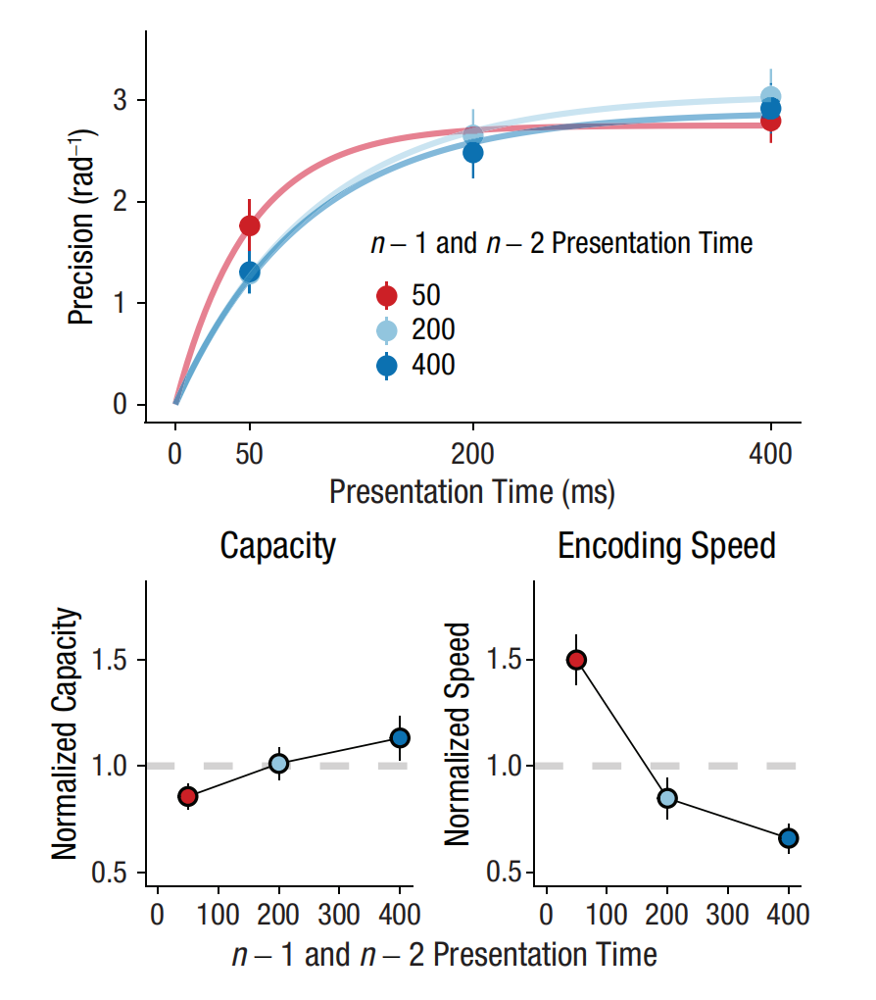
Figure 3
Figure 4

Slide 16
Results 3： cue information had no effect on both encoding speed and capacity
When the cue validity is at 80%, if the “fast” cue is effective, it would increase the encoding speed (β = -0.064, t = -0.77, p = .321, BF10 = 0.306, ΔBIC = -2.36; Figure 5). In fact, one-sided BF suggests that the “fast” cue does not improve the encoding speed (BF10 >= 0.098).
Researchers also found that cues have no effect on capacity (β = 0.052, t = 0.957, p = .19, BF10 = 0.47, ΔBIC = -1.52).

Slide 17
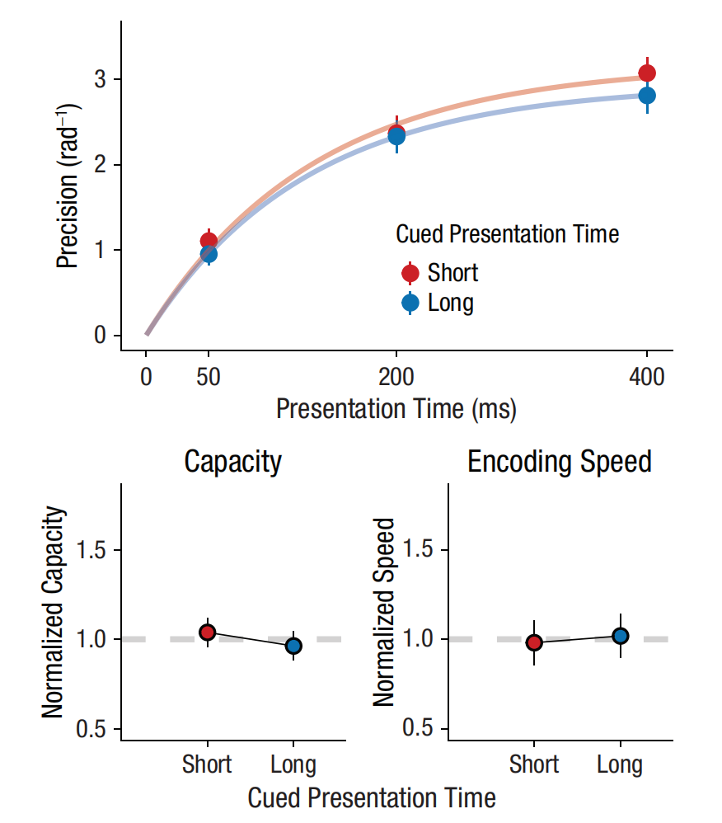
Figure 5

Slide 18
Experiment 1 Results Analysis Code Reproduction

Slide 19
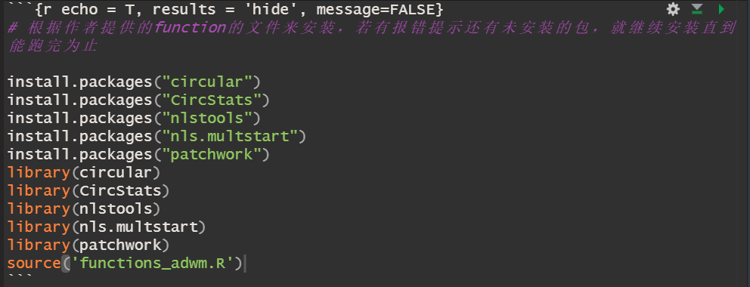
Install packages

Slide 20
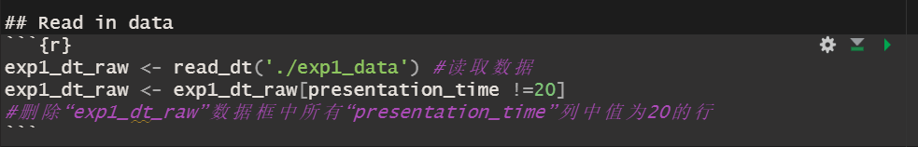
Read in data

Slide 21
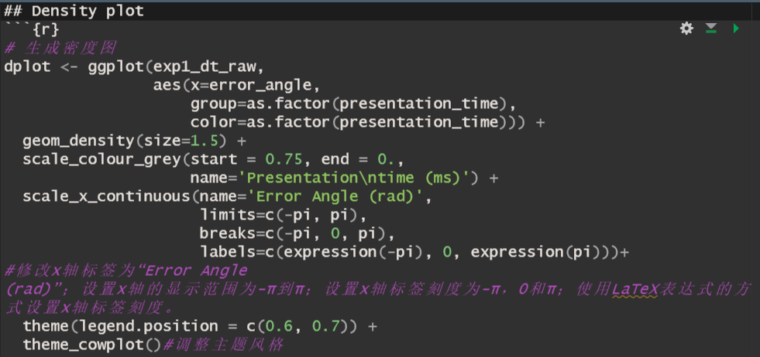
Density plot

Slide 22
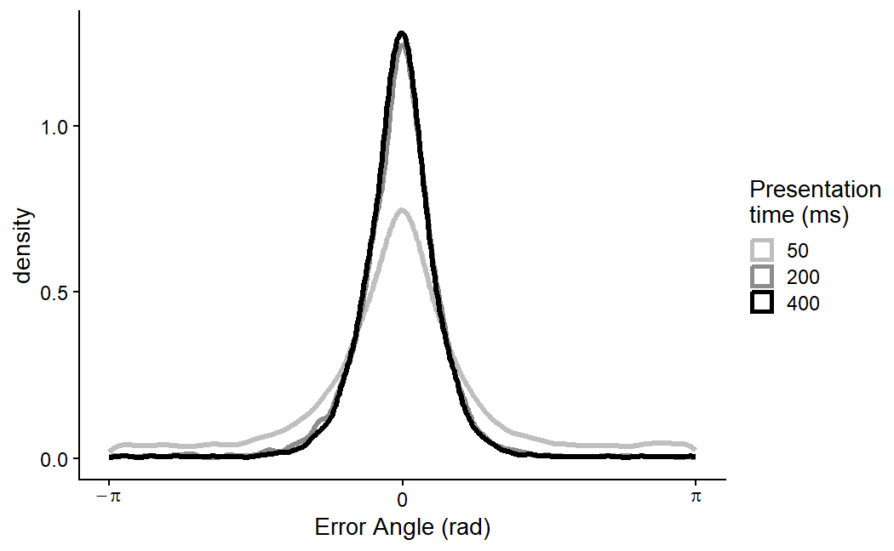
Density plot

Slide 23
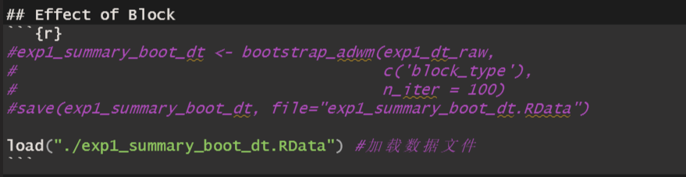
Effect of Block

Slide 24
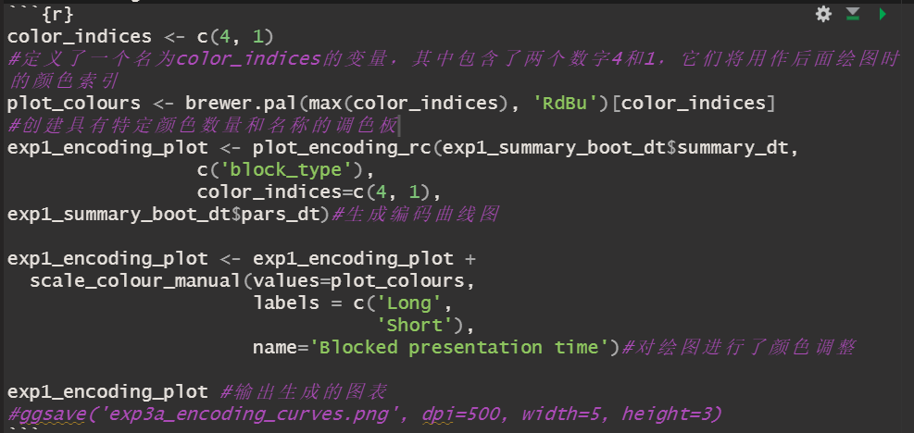
Encoding curves

Slide 25
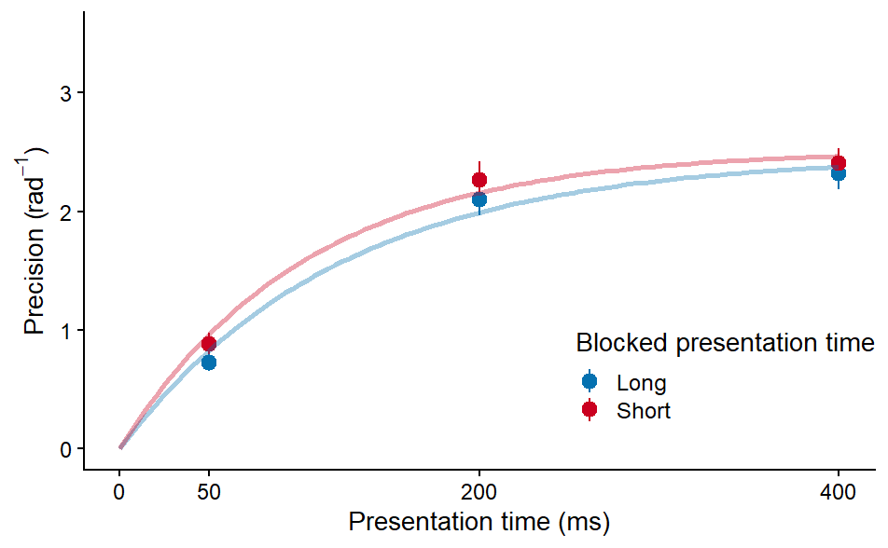
Encoding curves

Slide 26
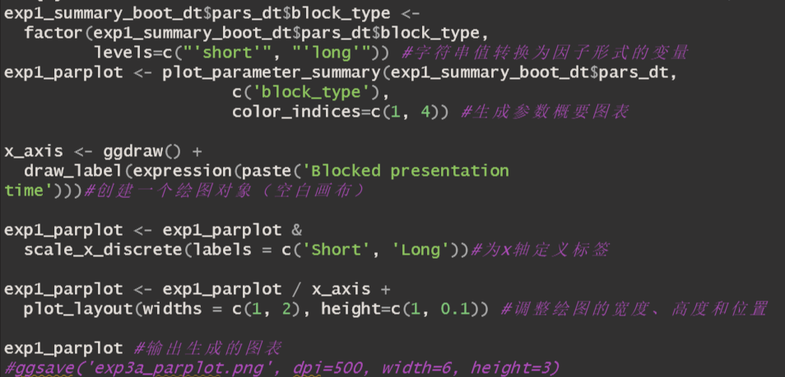
Parameter plots

Slide 27
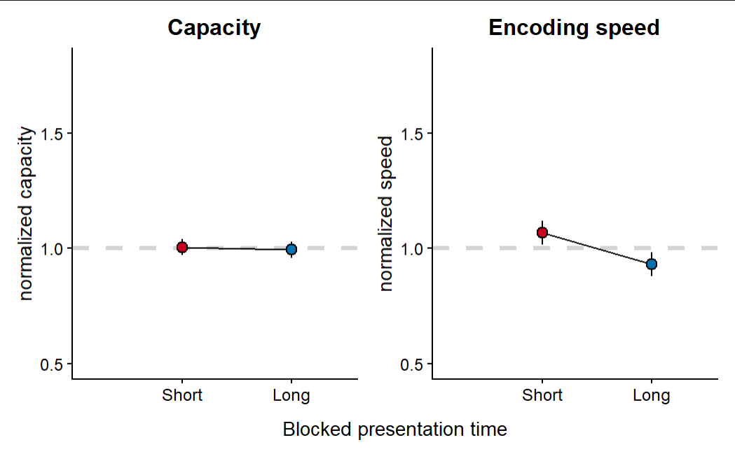
Parameter plots

Slide 28
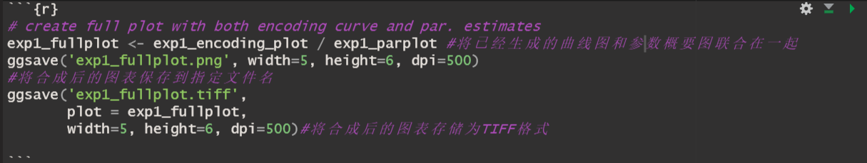
Create full plot

Slide 29
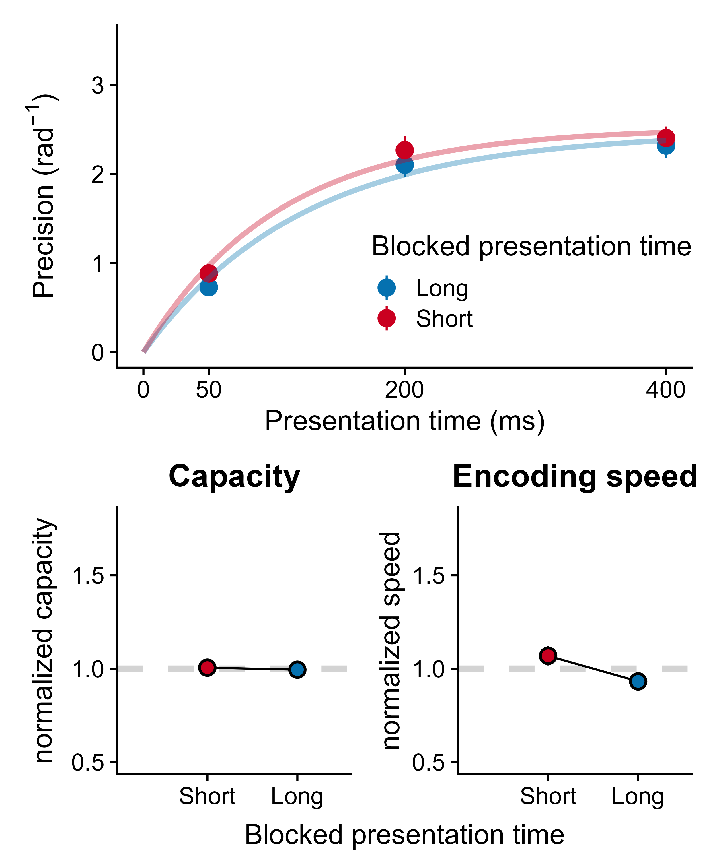
Create full plot

Slide 30
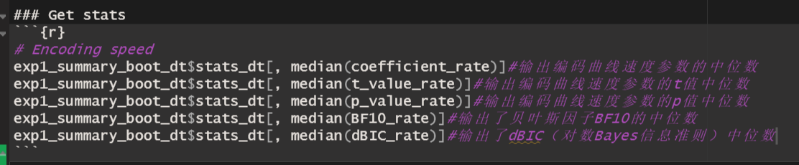
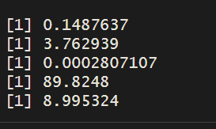
Encoding speed

Slide 31
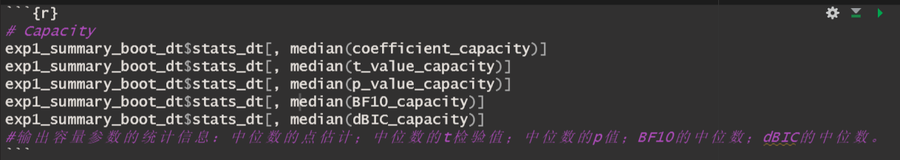
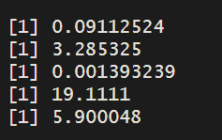
Capacity

Slide 32
Discussion
How do we keep up with the rate at which information reaches our senses?
Fundamental underlying mechanism may be the adaptation of working memory encoding speed to expected presentation time
Encoding-speed adaptations could not be induced by highly informative cues, suggesting that these adaptations may be largely implicit
The speed of working memory encoding is optimally adapted to the timescale of incoming information

Slide 33
Discussion
Theoretical Support
Formal models of adaptive dynamics could be a powerful way to conceptualize encoding-speed adaptations in working memory
Humans attempt to maximize their net gain and participants weigh performance at certain presentation times by their subjective probability

Slide 34
Conclusion
Humans implicitly speed up encoding in working memory when they expect information to be briefly available
Encoding-speed adaptations are probably not due to amplified visual inputs but may instead constitute actual speedups in neural processes themselves
Encoding-speed adaptations in working memory are critical for optimal performance in environments where the pace may change suddenly and substantially

Slide 35
Reproduction Situation
Difficulty---6
Consistency---copy exactly
Questions

